Slide 1

Computer Science
Project 2021
Bank Management
Software
Put photo here
By,

Slide 2

Sri Kumaran Children’s Home, CBSE
Bangalore
Project Certificate
This is to certify that
………………...........................
Of Class XII has successfully completed the project work titled ------------------------------------------------------------------------------------ under the guidance of ------------------------------------during the academic year ___________in partial fulfillment of _____________practical examination conducted by AISSCE.
_____________________ ___________________
Internal Examiner External Examiner
___________________________
Principal
Date of Practical Examination : _______________
Name of the Candidate: ___________________________
Registration Number: ___________________________
Examination Centre: ___________________________

Slide 3
Index
Sl.
No.
Title
Page No.
1
Acknowledgement
4
2
Synopsis
5
3
System Requirements
6
4
Flow Diagram
7
5
System Design
8-10
6
ER Diagram
11
7
Data Files
12
8
Source Code
>create()
>login()
>moderator(), details()
>loans()
>savings()
>current()
>fixed()
13-25
13
14
15
16-17
18-20
21-23
23-25
9
Output Screenshots
26-28
10
Scope for improvement
29
11
Bibliography
30

Slide 4
Acknowledgement
The success of a project depends on the persistent efforts of the individuals projecting it, and the sustained support received from a few others who are equally responsible for their precious appreciation of such endeavors.
Our strength is all due to my honorable Principal, Mrs. Pushkala Parasuraman who has been an unending source of inspiration and support towards finishing this project.
We would like to express our deepest sense of gratitude to our computer teachers,
Mrs. Pavani Kanukollu and Mrs. Smitha Ravindran without whom we could not have completed this project.
We would also like to thank all our friends who have helped create such a project.
Our gratitude is extended to our parents, who have been a constant source of encouragement and support in the success of this project.
Last but not least, we would like to thank Almighty for enlightening, strengthening, and guiding us in the completion of this project.

Slide 5
Synopsis
Our aim for this project was to create a solution for bank employees and customers to manage bank accounts seamlessly with an easy-to-use and minimal interface that can be manipulated by even those with the most basic knowledge of computers.
Our platform is modular, highly customizable, and user-friendly. We're also using Python!, talk about using modern technologies!
There are hundreds of local banks in India right now, and this number is expected to keep growing. With our solution, we can help thousands of them to get up and running, using our platform as a base.
Happy banking!

Slide 6
System Requirements
Hardware
Any x86 compatible CPU from the last 15 years.
2GB or more Memory
Software
Python 3+
MySQL Community Server 8+

Slide 7
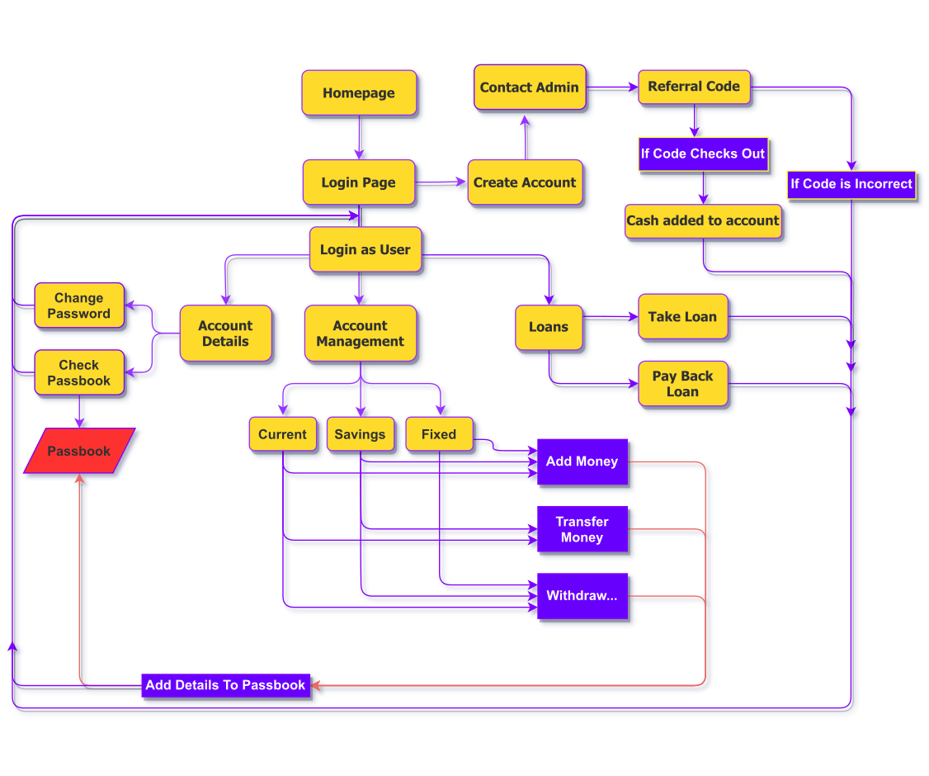
Flow Diagram

Slide 8
System Design
Sl.
No
Library/
Module
Purpose
1
Mysql.connector
Enables python programs to access mysql databases
2
random
Implements pseudo-random number generators for various distributions, including integers, float (real)
3
time
Provides many ways to represent time in code, such as objects, numbers, and strings
4
csv
Provides functionality to read,
write, and process data from and
to CSV files
5
re
This module provides regular expression matching operations

Slide 9
System Design
Sl.
No
Function
Uses
1
custid()
Creation of Customer ID
for new users
2
create()
Creation of a New user Account
3
login()
Provides options for user
login, and creation
4
otp(),
captcha()
Functions for bot-checking
5
createcode(), referralcode()
Creates and checks for
an Offer code
6
details()
Edit user Account details and
view passbook
7
loans()
Allows User to take loans
8
check(email)
Validate User’s Email Id
9
moderator()
Executes Admin Account
10
accountno()
Returns User’s Account Number

Slide 10
System Design
Sl.
No
Function
Uses
11
current()
Implements current Account
12
fixed()
Implements Fixed Account
13
interest(rate)
Implements interest for
various tasks
14
enter_passbook
(acnumber,money,c)
Records transaction details
of user
15
reading_passbook
(acnumber)
Allows User to View Passbook
16
MoneyToLoan-Account()
Function to pay loan back
17
svings()
Implements savings Account
18
loan_interest()
Calculates loan amount
19
heading_passbook(), enter_passbook(), reading_passbook()
Create, Enter details, and fetch data from Passbook

Slide 11
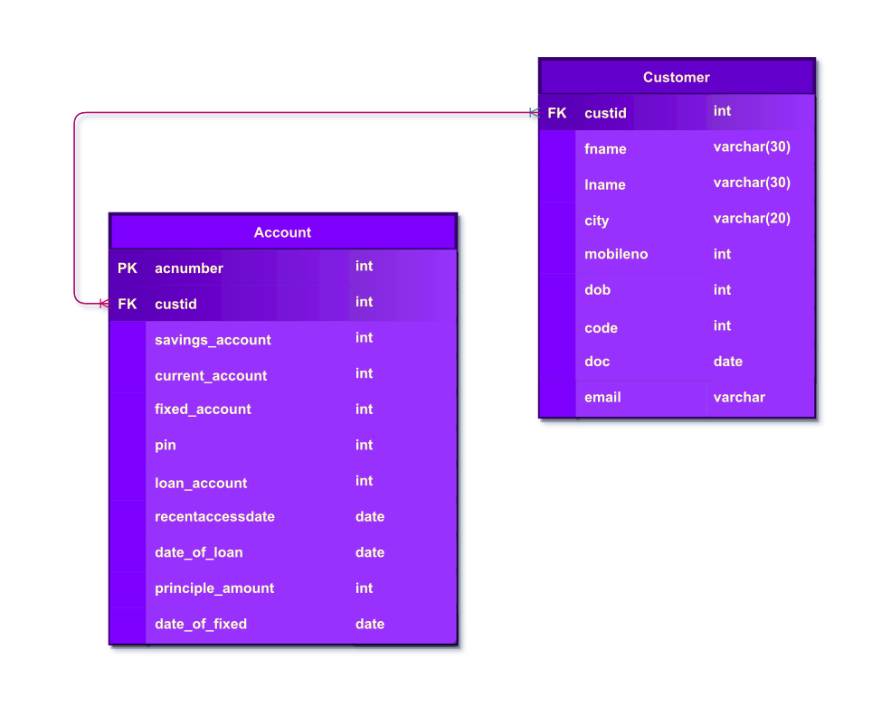
ER Diagram

Slide 12
Data Files
The following data files has been used in the program
Sl.
No
Data File(s)
Purpose
1
Passbook.csv
Used to store details of all
account activity
2
SQL Database
Records user data and all
related records

Slide 13
Source Code,
Create()
def create():
fname=input('Enter first name')
while fname==None:
print('Try again')
fname=input('Enter first name')
today=date.today()
dateofcreation=today
cust=custid()
lname=input('Enter last name')
while lname==None:
print('Try again')
lname=input('Enter last name')
city=input('Enter city')
while city==None:
print('Try again')
city=input('Enter city')
code=createcode()
moblieno=int(input('Enter mobile number'))
while len(mobileno)!=10:
print('Try again')
moblieno=int(input('Enter mobile number'))
dob=date(input('Enter date of birth(yyyy-mm-dd)'))
delta=today-dob
while delta.years<18:
print('Cannot create account')
break
regex ='^[a-z0-9]+[\._]?[a-z0-9]+[@]\w+[.]\w{2,3}$'
email=input('Enter your Email ID')
while check(email)=='Invalid Email':
print('Try again')
email=input('Enter your Email ID')
b=captcha()
print(b)
a=input('Enter the above captcha')
if a==b:
sql='insert into customer values(%s,%s,%s,%s,%s,%s,%s,%s,%s);'
data=(cust,fname,lname,city,moblieno,dob,code,dateofcreation,email)
mycursor.execute(sql,data)
sql='insert into account values(%s,%s,%s,%s,%s,%s,%s,%s,%s,%s,%s);'
pin=int(input('Create your four digit pin'))
data=(accountno(),cust,0,0,0,pin,0,dob,None,0,None)
mycursor.execute(sql,data)
con.commit()
referralcode()
print('Account created')
print('Your account number is',data[0])
else:
print('Wrong captcha entered')

Slide 14
Source Code,
Login()
def login():
global ac_no
ac_no=input('Enter your account number')
pin=int(input('Enter your pin number'))
if ac_no==12344 and pin==7:
moderator()
check=''
sql='select * from account where acnumber="%s" and pin=%s'%(ac_no,pin)
mycursor.execute(sql)
try:
check=mycursor.fetchall()
except:
check=''
if bool(check) == True:
print('You have successfully logged in')
today=date.today()
rad='select recentaccessdate from account where acnumber=%s and pin=%s'%(int(ac_no),pin)
mycursor.execute(rad)
rad=mycursor.fetchall()
rad=rad[0][0]
con.commit()
#rad=datetime.datetime.strptime(rad,'%Y-%m-%d')
delta=today-rad
datediff=delta.days
bsav='select savings_account from account where acnumber=%s and pin=%s'%(int(ac_no),pin)
mycursor.execute(bsav)
bsav=mycursor.fetchall()
bsav=bsav[0][0]
i=0
while i<datediff:
if bsav!='NULL':
r=bsav*0.02
bsav+=r
i+=1
sql='update account set savings_account=%s where acnumber=%s'%(bsav,ac_no)
mycursor.execute(sql)
sql='update account set recentaccessdate=%s where acnumber=%s;'
data=(today,ac_no)
mycursor.execute(sql,data)
con.commit()
return 'y'
else:
print('Account number or password is wrong')
return 'x'

Slide 15
Source Code,
Moderator(), details()
def moderator():
print('1 To create account\n2 To delete account')
a=int(input('Enter your choice'))
if a==1:
create()
elif a==2:
acno=int(input('Enter the Account number of the account you want to delete'))
mycursor=con.cursor()
sq='select custid from account where acnumber=%s'(acno)
mycursor.execute(sq)
res=mycursor.fetchall()
res=res[0][0]
sql='delete from account where custid=%s'%(res)
sql1='delete from customer where custid=%s'%(res)
mycursor.execute(sql)
mycursor.execute(sql1)
con.commit()
def details():
print('''1 to change password
2 to check passbook''')
i=input('enter your choice')
mycursor=con.cursor()
if i=='1':
b=input('account_no.')
a=input('enter your passord')
sql='select pin from account where acnumber="%s";'%(b)
mycursor.execute(sql)
pswd=mycursor.fetchall()
pswd=pswd[0][0]
if int(a)==pswd:
newpswd=input('Enter new password')
sql='update account set pin=%s where pin=%s;'
data=(newpswd,pswd)
mycursor.execute(sql,data)
con.commit()
print('Change successful')

Slide 16
Source Code,
Loans()
def loans():
amount=int(input('Enter amount to be taken as a loan')
if amount<0:
amount=int(input(‘Enter the amount with positive nubers’))
if amount<100000:
print('Eligible for 6 month loan')
sql='update account set loan_time_period=%s where acnumber=%s'%(6,ac_no)
#acno=input('Enter account number')
pin=int(input('Enter pin'))
loan_amount=amount+loan_interest()
sql='update account set loan_amount=%s where acnumber=%s'%(amount,ac_no)
mycursor.execute(sql)
con.commit()
sql1='update account set current_account=current_account+%s where acnumber="%s" and pin=%s'%(loan_amount,acno,pin)
mycursor.execute(sql1)
print('You need to pay',loan_amount*1.2//6,'every month')
con.commit()
elif amount>=100000:
print('Consult our loan manager,cap')
def MoneyToLoanAccount():
#acno=input('Enter account number')
pin=int(input('Enter pin'))
sql='select loan_account from account where acnumber="%s" and pin=%s'%(ac_no,pin)
mycursor.execute(sql)
result=mycursor.fetchall()
result=result[0][0]
#result+=loan_interest()
#sql='update account set loan_account=%s where acnumber="%s" and pin=%s'%(result,ac_no,pin)
#mycursor.execute(sql)
con.commit()

Slide 17
Source Code,
Loans()
print('The amount to be paid is',result*1.2//6)
today=date.today()
rad='select date_of_loan from account where acnumber=%s and pin=%s'%(int(ac_no),pin)
mycursor.execute(rad)
rad=mycursor.fetchall()
rad=rad[0][0]
con.commit()
#rad=datetime.datetime.strptime(rad,'%Y-%m-%d')
delta=today-rad
datediff=delta.days
if datediff==30 or datediff==60 or datediff==90 or datediff==120 or datediff==150 or datediff==180:
#amount=int(input('Enter money to pay to bank'))
amount=result/6
sql='select savings_account from account where acnumber="%s" and pin =%s'%(ac_no,pin)
mycursor.execute(sql)
result=mycursor.fetchall()
result=result[0][0]
if amount>result:
print('Insufficient funds')
else:
result-=amount
sql='update account set savings_account=%s where acnumber="%s" and pin=%s'%(result,ac_no,pin)
mycursor.execute(sql)
con.commit()
sql='select loan_account from account where acnumber="%s" and pin=%s'%(ac_no,pin)
mycursor.execute(sql)
result=mycursor.fetchall()
result=result[0][0]
result-=amount
sql='update account set loan_account=%s where acnumber="%s" and pin=%s'%(result,ac_no,pin)
mycursor.execute(sql)
con.commit()

Slide 18
Source Code,
Savings()
def svings():
print('1 to Add\n2 to Transfer\n3 Cash withdrawl\n 4Exit')
a=int(input('Enter your choice'))
if a==1:
con=mysql.connector.connect(host='localhost',user='root',passwd='doggydon',database='bank')
if con.is_connected():
try:
mycursor=con.cursor()
money=int(input('enter amount of money'))
if money<0:
money=int(input(‘enter positive amount only’))
sql='select savings_account from account where acnumber="%s"'%(ac_no)
mycursor.execute(sql)
balance_sav=mycursor.fetchall()
balance_sav=balance_sav[0][0]
balance_sav+=money
sql2='update account set savings_account=%s where acnumber="%s"'%(balance_sav,ac_no)
mycursor.execute(sql2)
enter_passbook(ac_no,money,'credited,added','NA')
print(‘your account balance is’,balance_sav)
con.commit()
finally:
con.close()

Slide 19
Source Code,
Savings()
elif a==2:
con=mysql.connector.connect(host='localhost',user='root',passwd='doggydon',database='bank')
if con.is_connected():
try:
mycursor=con.cursor()
sql9='select loan_account from account where acnumber="%s" and pin=%s'%(ac_no,pin)
mycursor.execute(sql9)
result=mycursor.fetchall()
result=result[0][0]
result=result/6
con.commit()
a=int(input('Enter amount of money to be tranferred'))
if a <0:
a=int(input(‘enter positive amount only’))
b=int(input('enter account no. of recipient'))
sql1='select savings_account from account where acnumber="%s"'%(ac_no)# add money as name
sql2='select savings_account from account where acnumber="%s"'%(b)
mycursor.execute(sql1)
balance_sav=mycursor.fetchall()
balance_sav=balance_sav[0][0]
if balance_sav>a+result+500:
mycursor.execute(sql2)
balance_sav2=mycursor.fetchall()
balance_sav2=balance_sav2[0][0]
balance_sav2+=a
mycursor.execute(sql1)
balance_sav=mycursor.fetchall()
balance_sav=balance_sav[0][0]
balance_sav-=a
else:
print('Minimum balance violated cannot transact')
sql='update account set savings_account={} where acnumber={}'.format(balance_sav2,b)# add money as name
sql2='update account set savings_account={} where acnumber={}'.format(balance_sav,ac_no)
mycursor.execute(sql)
mycursor.execute(sql2)
con.commit()
print(‘your account balance is’,balance_sav)
enter_passbook(ac_no,a,'transferred',b)
enter_passbook(b,a,'recieved',b)
finally:
con.close()

Slide 20
Source Code,
Savings()
elif a==3:
con=mysql.connector.connect(host='localhost',user='root',passwd='doggydon',database='bank')
if con.is_connected():
try:
mycursor=con.cursor()
sql9='select loan_account from account where acnumber="%s" and pin=%s'%(ac_no,pin)
mycursor.execute(sql9)
result=mycursor.fetchall()
result=result[0][0]
result=result/6
con.commit()
#ac_no=input('Enter your account number')
a=int(input('Enter amount of money'))
if a<0:
a=int(input(‘enter positive amount only’))
sql1='select savings_account from account where acnumber="%s";'%(ac_no)# add money as name
mycursor.execute(sql1)
balance_sav=mycursor.fetchall()
balance_sav=balance_sav[0][0]
if balance_sav>a+result+500:
balance_sav-=a
sql='update account set savings_account={} where acnumber={}'.format(balance_sav,ac_no)# add money as name
mycursor.execute(sql)
print(‘your account balance is’,balance_sav)
enter_passbook(ac_no,a,'debited,withdrawn','NA')
con.commit()
else:
print('Minimum balance violated cannot transact')
finally:
con.close()
elif a==4:
pass

Slide 21
Source Code,
Current()
def current():
print('1 to Add\n2 to Transfer\n3 Cash withdrawl\n')
a=int(input('enter your choice'))
if a==1:
con=mysql.connector.connect(host='localhost',user='root',passwd='doggydon',database='bank')
if con.is_connected():
try:
mycursor=con.cursor()
#ac_no=int(input('Enter your account number'))
a=int(input('enter amount of money'))
if a<0:
a=int(input(‘enter positive amount only’))
sql1='select current_account from account where acnumber="%s"'%(ac_no)# add money as name
mycursor.execute(sql1)
balance_sav=mycursor.fetchall()
balance_sav=balance_sav[0][0]
balance_sav+=a
sql='update account set current_account="%s" where acnumber="%s"'%(balance_sav,ac_no)# add money as name
mycursor.execute(sql)
print(‘your account balance is’,balance_sav)
enter_passbook(ac_no,a,'credited,added','NA')
con.commit()
finally:
con.close()

Slide 22
Source Code,
Current()
elif a==2:
con=mysql.connector.connect(host='localhost',user='root',passwd='doggydon',database='bank')
if con.is_connected():
try:
mycursor=con.cursor()
a=int(input('enter amount of money'))
if a<0:
a= int(input(‘Enter positive amount only’))
#ac_no=int(input('Enter your account number'))
b=int(input('enter account no. of recipient'))
sql1='select current_account from account where acnumber={}'.format(ac_no)# add money as name
sql2='select current_account from account where acnumber={}'.format(b)
mycursor.execute(sql1)
balance_sav=mycursor.fetchall()
balance_sav=balance_sav[0][0]
if balance_sav>a+1000:
mycursor.execute(sql2)
balance_sav2=mycursor.fetchall()
balance_sav2=balance_sav2[0][0]
balance_sav2+=a
mycursor.execute(sql1)
balance_sav=mycursor.fetchall()
balance_sav=balance_sav[0][0]
balance_sav-=a
else:
print('Minimum balance violated cannot transact')
sql='update account set current_account={} where acnumber={}'.format(balance_sav2,b)# add money as name
sql2='update account set current_account={} where acnumber={}'.format(balance_sav,ac_no)
mycursor.execute(sql)
mycursor.execute(sql2)
con.commit()
print(‘your account balance is’,balance_sav)
enter_passbook(ac_no,a,'transferred',b)
enter_passbook(b,a,'recieved',b)
finally:
con.close()

Slide 23
Source Code,
Current()
elif a==3:
con=mysql.connector.connect(host='localhost',user='root',passwd='doggydon',database='bank')
if con.is_connected():
try:
mycursor=con.cursor()
a=int(input('enter amount of money'))
if a<0:
a=int(input(‘Enter positie amount only’))
#ac_no=int(input('Enter account number'))
sql1='select current_account from account where acnumber={};'.format(ac_no)# add money as name
mycursor.execute(sql1)
balance_sav=mycursor.fetchall()
balance_sav=balance_sav[0][0]
if balance_sav>a+1000:
balance_sav-=a
sql='update account set current_account={} where acnumber={};'.format(balance_sav,ac_no)# add money as name
mycursor.execute(sql)
print(‘your account balance is’,balance_sav)
enter_passbook(ac_no,a,'debited,withdrawn','NA')
con.commit()
else:
print('Minimum balance violated cannot transact')
finally:
con.close()
elif a==4:
pass

Slide 24
Source Code,
Fixed()
def fixed():
print('1 to create FD\n2 FD withdrawl\n3 Exit')
a=int(input('enter your choice'))
if a==1:
con=mysql.connector.connect(host='localhost',user='root',passwd='doggydon',database='bank')
if con.is_connected():
try:
mycursor=con.cursor()
#ac_no=int(input('Enter account number'))
sql='select fixed_deposit from account where acnumber=%s'%(ac_no)
mycursor.execute(sql)
fixed=mycursor.fetchall()
fixed=fixed[0][0]
if fixed==0:
a=int(input('Enter amount of money'))
if a<0:
a=int(input(‘Enter positive amount only’))
sql1='select fixed_deposit from account where acnumber=%s'%(ac_no)# add money as name
mycursor.execute(sql1)
balance_sav=mycursor.fetchall()
balance_sav=balance_sav[0][0]
balance_sav+=a
sql='update account set fixed_deposit=%s where acnumber=%s'%(balance_sav,ac_no)# add money as name
mycursor.execute(sql)
today=date.today()
sql='update account set date_of_fixed=%s where acnumber=%s'%(today)
mycursor.execute(sql)
enter_passbook(ac_no,a,'credited,added','NA')
con.commit()
else:
print('Cannot add funds yet')
finally:
con.close()

Slide 25
Source Code,
Fixed()
elif a==2:
con=mysql.connector.connect(host='localhost',user='root',passwd='doggydon',database='bank')
if con.is_connected():
try:
mycursor=con.cursor()
#ac_no=int(inpur('Enter account number'))
pin=int(input('Enter pin'))
sql='select date_of_fixed from account where acnumber=%s and pin=%s'%(ac_no,pin)
mycursor.execute(sql)
dof=mycursor.fetchall()
dof=dof[0][0]
dof=datetime.datetime.strptime(dof,'%Y-%m-%d')
today=date.today
delta=today-dof
if delta.days>1825: #date atwhich FD ends
sql1='select fixed_deposit from account where acnumber=%s'%(ac_no)# add money as name
mycursor.execute(sql1)
balance_sav=mycursor.fetchall()
balance_sav=balance_sav[0][0]
datediff=1825
interest(0.01369)
sql='update account set fixed_deposit=%s where acnumber=%s'%(balance_sav,ac_no)# add money as name
mycursor.execute(sql)
print(balance_sav,'withdrawn')
sql='update account set fixed_deposit=0 and savings_account=savings_account+balance_sav where acnumber=%s'%(ac_no)
mycursor.execute(sql)
enter_passbook(ac_no,balance_sav,'debited,withdrawn','NA')
mycursor.commit()
else:
print('Cannot remove funds yet')
finally:
con.close()
elif a==3:
pass

Slide 26
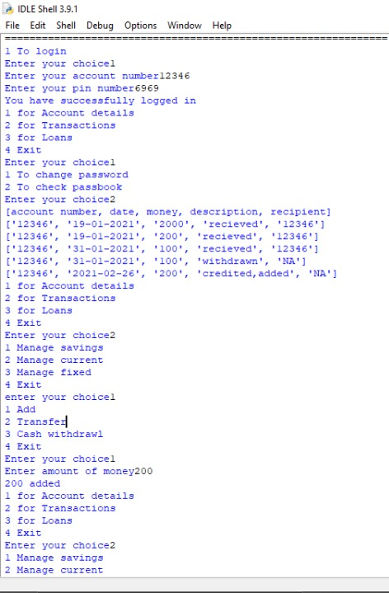
Output
Screenshots

Slide 27
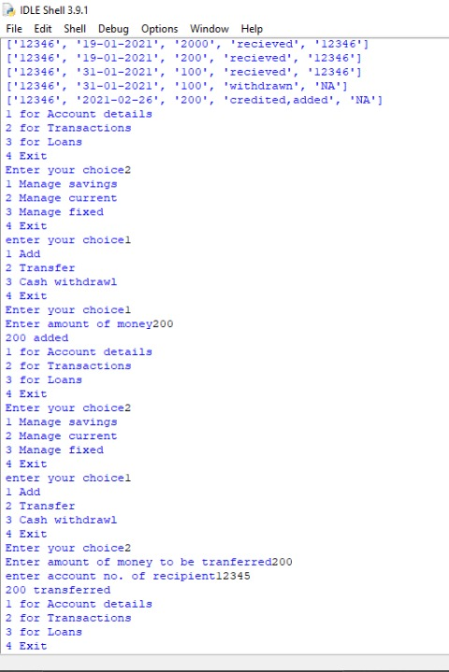
Output
Screenshots

Slide 28
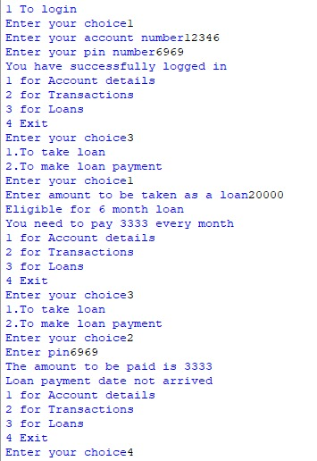
Output
Screenshots

Slide 29
Scope for Improvement
Implement a GUI
Optimize to work on all platforms
General code efficiency

Slide 30
Bibliography
Computer Science with Python For Class 12 By Sumita Aurora
Computer Science with Python For Class 11 By Sumita Aurora
https://Geeksforgeeks.com
https://millennialmoneyman.com/how-interest-works/
https://www.hdfcbank.com/personal/resources/learning-centre/

